Slide 1

Literature Retrieval Agent using Python & Crossref
MSc Artificial Intelligence – Development Individual Project

Slide 2
overview
Automates metadata retrieval using Crossref API (via Habanero)
Developed in Python following BDI-inspired design
Agents: Search, Extraction, and Storage
Ethical, modular, and lightweight
Introduction – Problems and Goals
Solution – MaS with BDI
Architecture – Agents and Data Flow
Key Components – Design Decisions
Running and Testing
Ethical and Technical Aspects
Limitations – Challenges and Improvements
Conclusions

Slide 3
Introduction
Automated MAS:
Fast and structured
Consistent metadata
Easy to scale
Manual Search
Time-consuming
Prone to inconsistency
Repetitive manual recording
The aim is to automate metadata collection (titles, authors, DOIs), enabling researchers to analyze structured data quickly with bypassing the tedious manual literature search

Slide 4
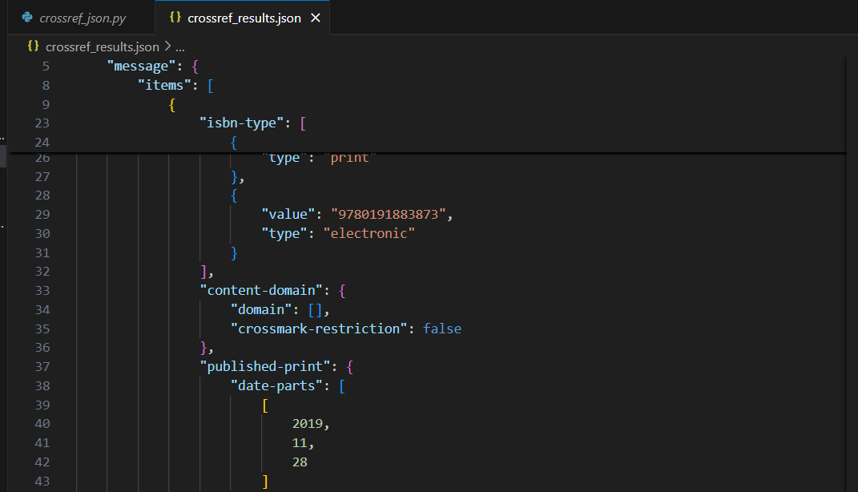
solution
Implemented a Multi-Agent System (MAS) in Python, following BDI
Uses Crossref REST API via Habanero instead of web scraping
Safe, ethical, and efficient metadata retrieval
Focused on reliability and clean data output
Fig 1. Snippet of the output from the Search Agent, showing raw metadata retrieved from Crossref before validation and transformation.

Slide 5
Architecture
Search Agent
Queries Crossref database for results based on search term
Extraction Agent
Structures, validates and cleans the metadata for consistency
Storage Agent
Stores data in a JSON format for universal compatibility
Orchestrator – manages all agent tasks

Slide 6
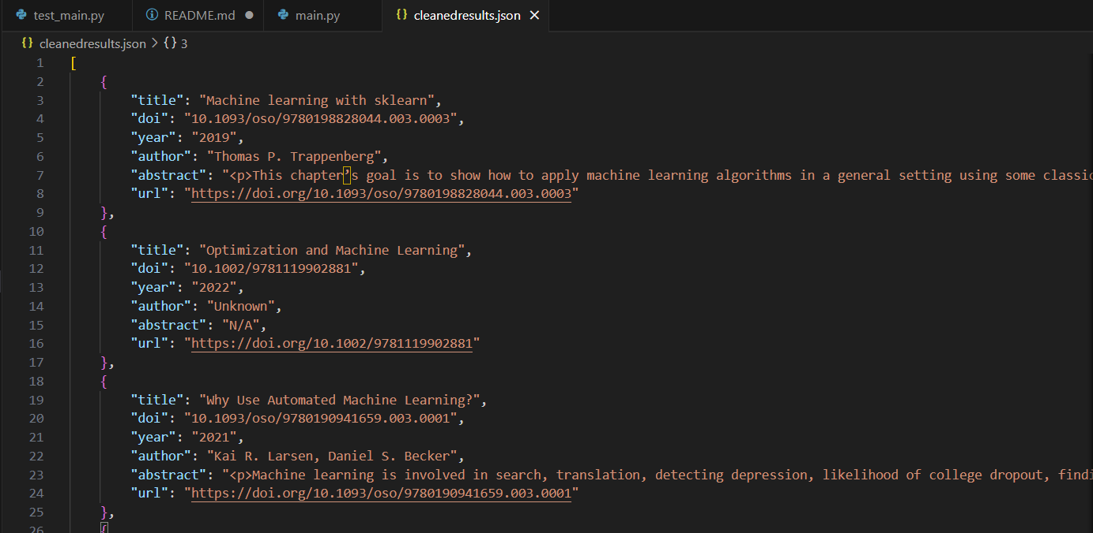
Key Components and Choices
Crossref API ensures accurate and ethical retrieval
Validation filters incomplete records
Transformation removes duplicates, normalizes names
Output stored as cleanedresults.json
Fig. 2 – cleanedresults.json output file

Slide 7
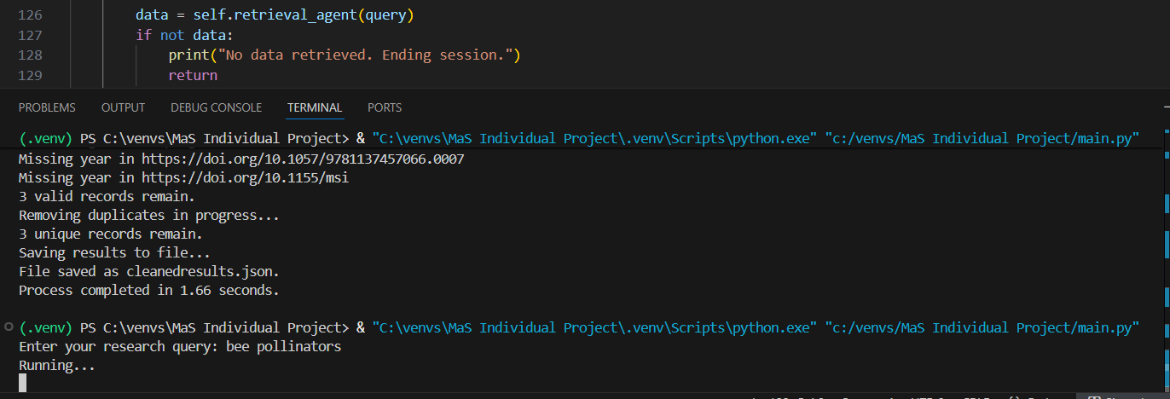
Running and Testing
System requests query input
Retrieves, validates, transforms, and stores metadata
Includes timing and validation feedback
Tests confirm all agents run correctly
Fig. 3 – Demonstration of the script running after entering the search term “bee pollinators”

Slide 8
Ethical and Technical Aspects
The system uses Crossref’s official API instead of HTML scraping, avoiding ethical issues like violating site policies or overloading servers.
API calls are limited to a small number of results to keep the system lightweight and efficient.
Not all metadata is complete, which is a common issue in academia. Missing abstracts, incomplete author lists, and publisher identification challenges are frequent.
Limiting results reduces diversity. Randomization was tested by increasing the limit to 20 and shuffling, but simplicity and consistency were prioritized.
Outputs are saved in JSON, preserving structure and supporting Unicode for multilingual titles and author names.
The workflow is transparent and reproducible, following open data principles.

Slide 9
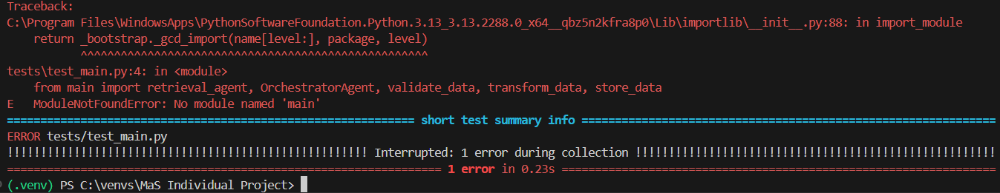
Limitations and Future Work
Crossref’s coverage is not universal, some metadata is incomplete or missing, and in some cases query words trigger a network timeout, as seen in figure 4 below
Future: integrate more APIs, parallel agents, keyword filtering
Fig 4. – attempt at pytest with query “cheese”

Slide 10
Conclusions
BDI-inspired Multi-Agent System automates literature retrieval ethically and simply.
Sequential agent steps make reproductions and adaptations easy.
System is simple, reliable, and meets goals of identifying, processing, and storing research data.
Functional implementation proves even a modest system improves efficiency and consistency in research workflows.

Slide 11
References
Scott, S. (n.d.) Habanero: R and Python interface to the Crossref REST API. Available at: https://github.com/sckott/habanero (Accessed: 13 October 2025)
Chapman, A. L., Morgan, L. C., & Gartlehner, G. (2009) ‘Semi-automating the manual literature search for systematic reviews increases efficiency’, Health Information & Libraries Journal, 26(4), pp. 310–316. Available at: https://doi.org/10.1111/j.1471-1842.2009.00865.x (Accessed 12 October 2025)
Hendricks, G., Tkaczyk, D., Lin, J., & Feeney, P. (2020) ‘Crossref: The sustainable source of community-owned scholarly metadata’, Quantitative Science Studies, 1(1), pp. 414–427. Available at: https://doi.org/10.1162/qss_a_00022 (Accessed 12 October 2025)

